Slide 1


Estimate Store Potential Revenue on Diapers STATISTICAL LEARNING AND DATA ANALYSIS
Fater Geo-Analytics Challenge

Slide 2

Team NAVY
GIOVANNI MONTANILE
Management Engineer
KRISHAN KUMAR
Computer Science
Engineer
NAVYASHREE BYREGOWDA
Computer Science
Engineer
SANTOSH KUMAR YADAV
Electronics and Communication Engineer

Slide 3





Contents
Case Study
Exploratory data Analysis
Classification
Conclusion

Slide 4


Overview of this case study involves a comprehensive analysis of various factors influencing diaper sales across retail outlets in Naples. Key factors include socio-demographic data, territorial features, and points of interest near stores. Understanding these factors is crucial for developing effective marketing strategies and optimizing sales potential.

Slide 5
Gravitation_NA
Shapes_NA
Stores_NA
Socio_Demo_NA
They Offers socio-demographic insights into the local population, crucial for estimating diaper demand.
Quantifies store attractiveness based on factors like proximity to key points of interest, guiding identification of stores with high sales potential.
Provides spatial data for geographic analysis, including store locations and polygons for mapping.
Details store attributes and operational metrics, aiding identification of stores with sales improvement potential.
Datasets
Overview

Slide 6
Socio_demo_NA | Description
microcode | ISTAT Microcell (13-digit numeric code)
district | municipality
province | Microcell province
region | microcell region
population | total population
population_m | male population
population_f | female population
population_age_00-04_yr | population aged 0-04 years
population_age_05-14_yr | population aged 05-14 years
population_age_15-34_yr | population aged 15-34 years
population_age_35-44_yr | population aged 35-44 years
population_age_45-54_yr | population aged 45-54 years
population_age_55-64_yr | population aged 55-64 years
population_age_65-up_yr | population over 65 years
shapes_NA | Description | Value
Microcode | ISTAT microcell | Eg:0630010000001
Geometry | geometries of polygons that make up the microcells | Longitude Latitude
Datasets
Gravitation_NA
Shapes_NA
Socio_demo_NA
Stores_NA
Gravitation_NA | Description | Value
Microcode | ISTAT microcell | Eg:0630010000001
Datatype | This specify weekday and weekend | 1 > weekday 2 > weekend
Fasciaoraria | Specify time slot | 2 : 07-10 3 : 10-13 4 : 13-14 5 : 14-17 6 : 17-20
Datatype | Population | F1 : population under 18yrs F2 : population aged 18-30yrs F3 : population aged 31-40yrs F4 : population aged 41-50yrs F5 : population aged 51-60yrs F6 : population over 60yrs Gf : female population Gm : male population
Stores_NA | Description | Value
Cod3HD | store ID
TipologiaPdv | store type | IPR : Hypermarket SUP : Supermarket LIS : Libero Servizio SSD : Drugstore DIS : Discount
MQVEND | store size
Parking | If there is parking area | If available : True If not available : False
Indirizzo | store address
Lat | store latitude
Long | store longitude
Comune | store muncipality
Provincia | store province
Potenziale | thousandth of the Italian diaper market

Slide 7
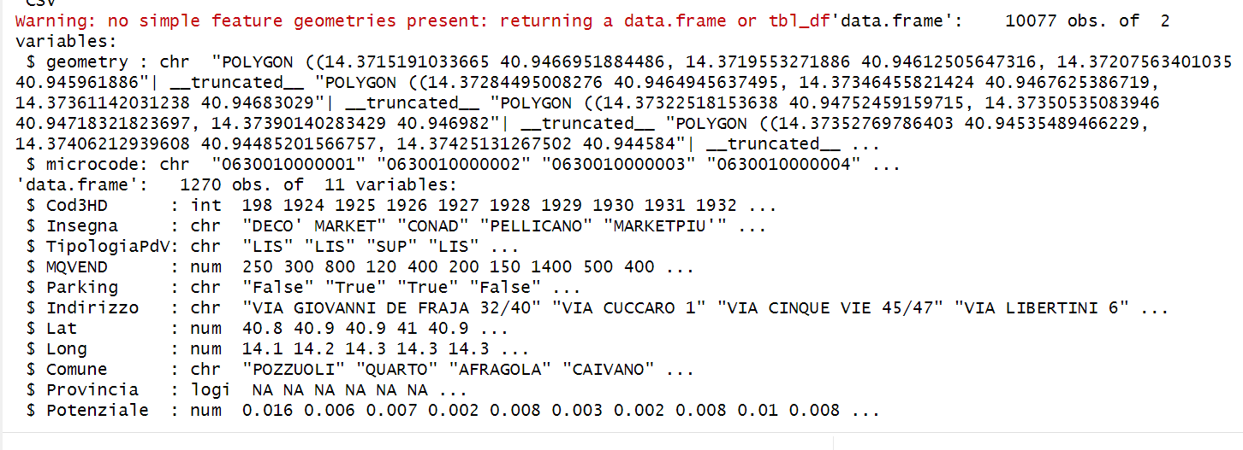
Data
Pre-processing
These steps are crucial for accessing and preparing the necessary spatial and store-related data for further analysis and visualization in our project report.

Slide 8

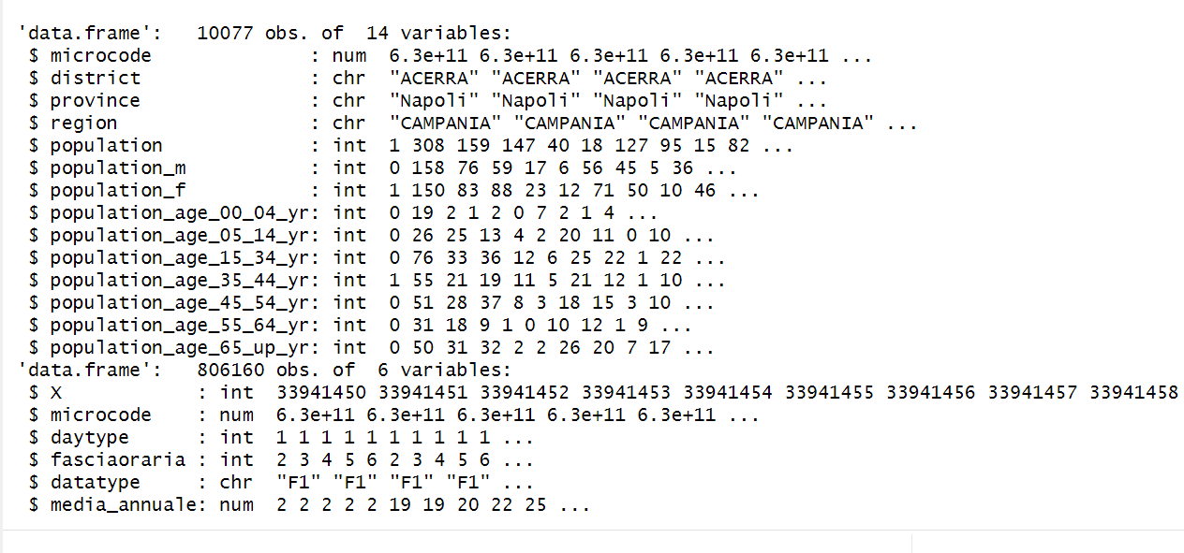
Data
Integration
Merging the tables using microcode as the primary key to the store data.
Assigning microcodes based on spatial relationship: If a store's location lies within a polygon, the corresponding microcode from the polygons_data dataframe is retrieved and assigned to the store's "microcode" column.

Slide 9
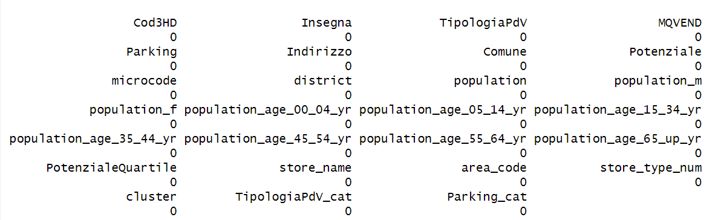
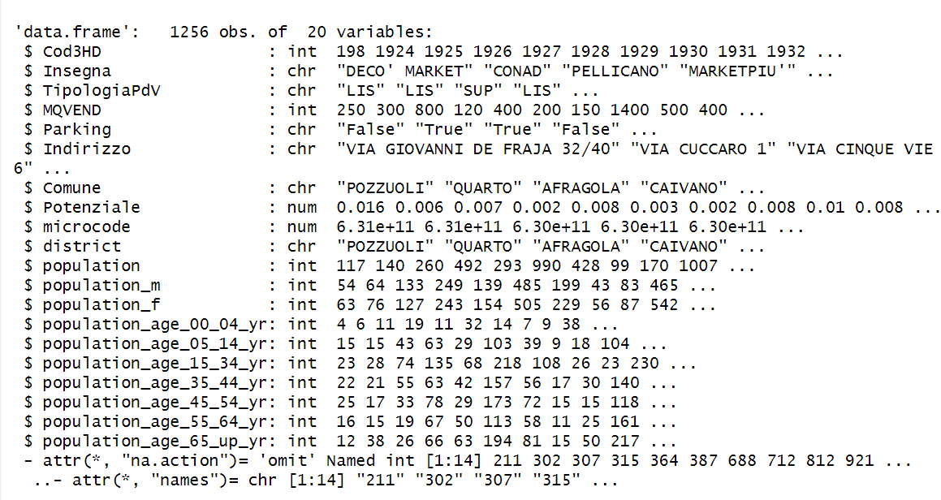
Data
Cleaning
Variable Reduction: To streamline the dataset and concentrate the analysis on pertinent variables, unnecessary variables Lat, Long, Provincia, region were removed.
Simplifies the dataset and enhances the focus on essential factors for analysis.
Handling Missing Values
Approach mitigates the risk of biases or inaccuracies stemming from incomplete data, thereby bolstering the robustness of subsequent analyses.

Slide 10

Exploratory Data Analysis

Slide 11
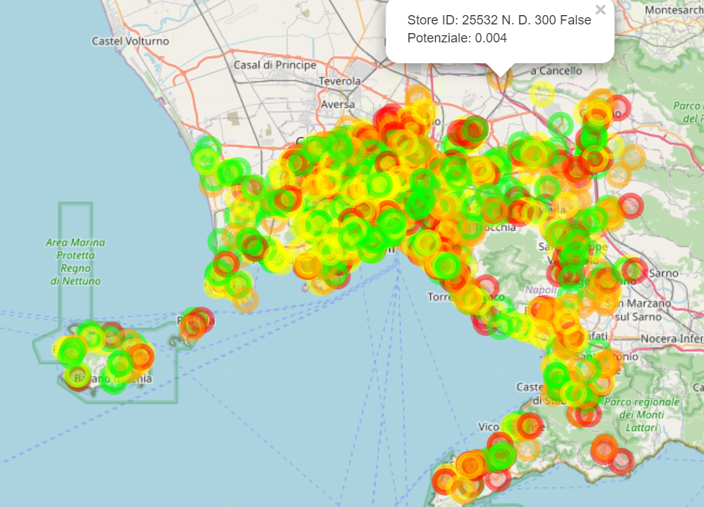
Map Representation
Visualizing Store Distribution and Potential on Interactive Map.
The map displays circle markers representing individual stores, allowing for intuitive exploration of their spatial distribution.
From the markers, we can access additional information about each store, facilitating in-depth analysis and decision-making processes.
Store Potential (in quantile percentage) :
RED: 0-25 Orange: 25-50
Yellow: 50-75 GREEN: 75-100

Slide 12
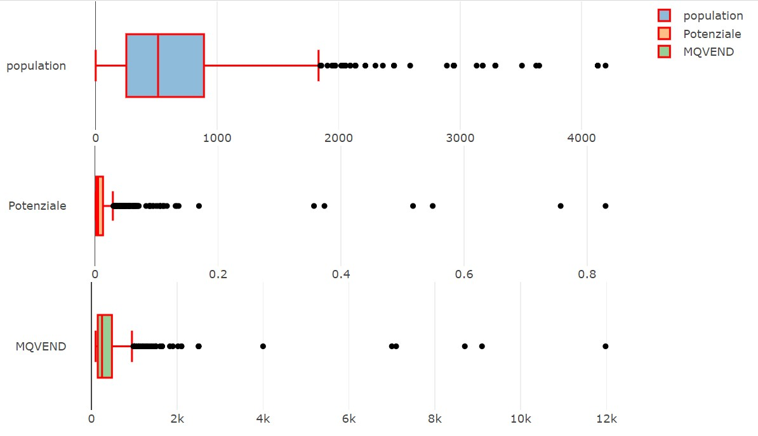
Box Plot
Box plots are particularly useful for visualizing the distribution and central tendency of numerical data.
Makes them well-suited for exploratory data analysis and identifying patterns or outliers within the data.
Outliers, quartiles, and median values are visually represented within each box plot, for the interpretation of the data distribution.

Slide 13
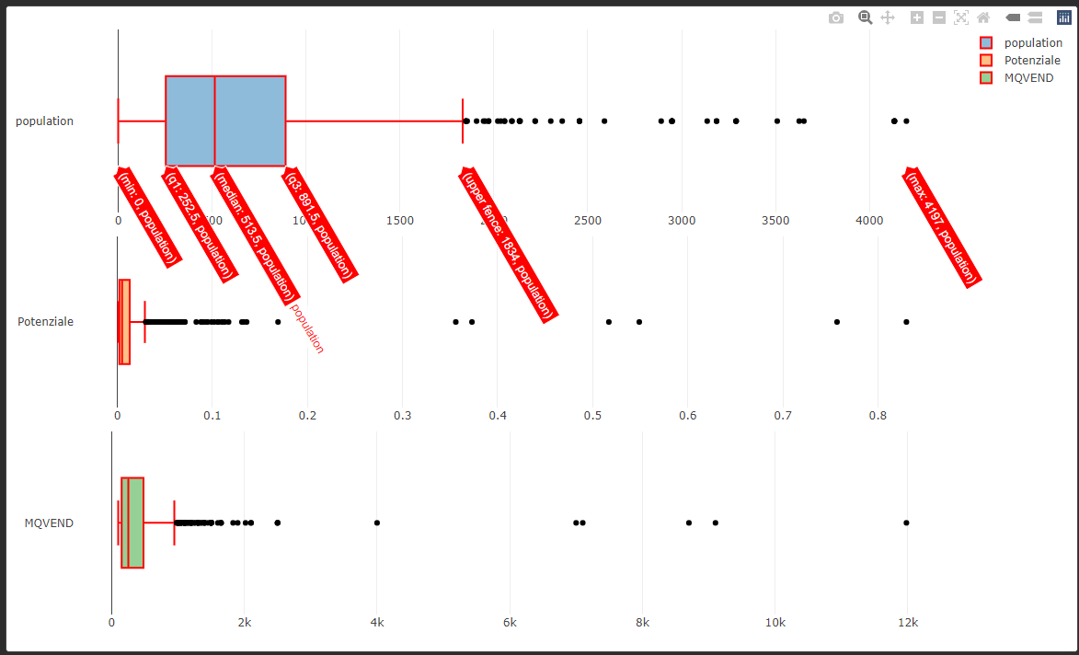
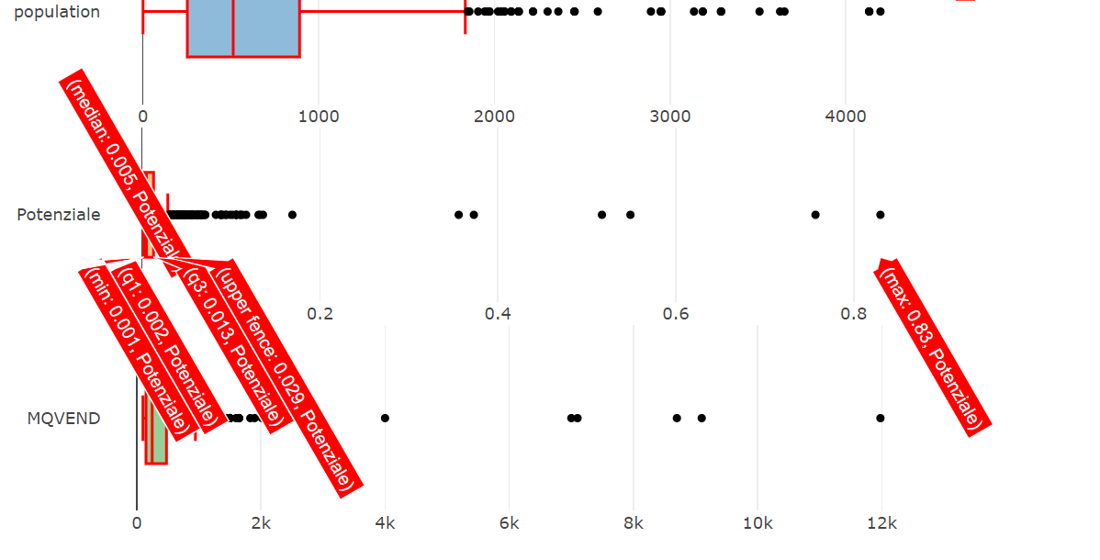
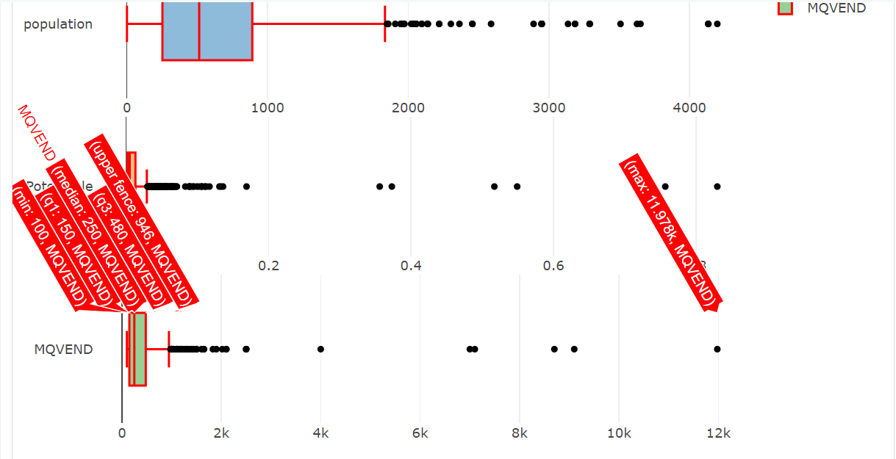
Outliers have the potential to significantly impact our analysis and should be carefully considered in our further investigations.

Slide 14
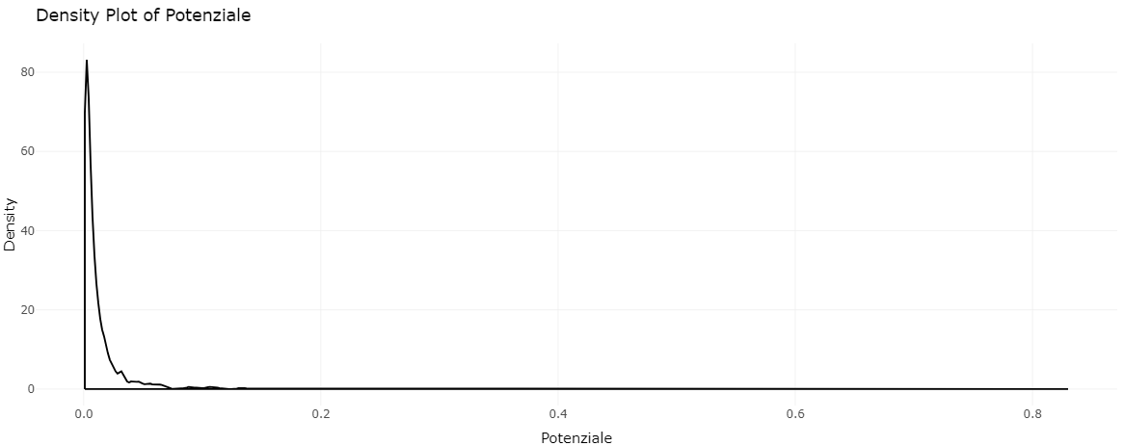
Density plot of Potenziale
Density plots are a useful tool in data analysis for visualizing the distribution of a continuous variable.
It gain insights into the data before performing more advanced analyses.
They provide an intuitive identifying patterns, skewness, multimodality and outlier detection.

Slide 15
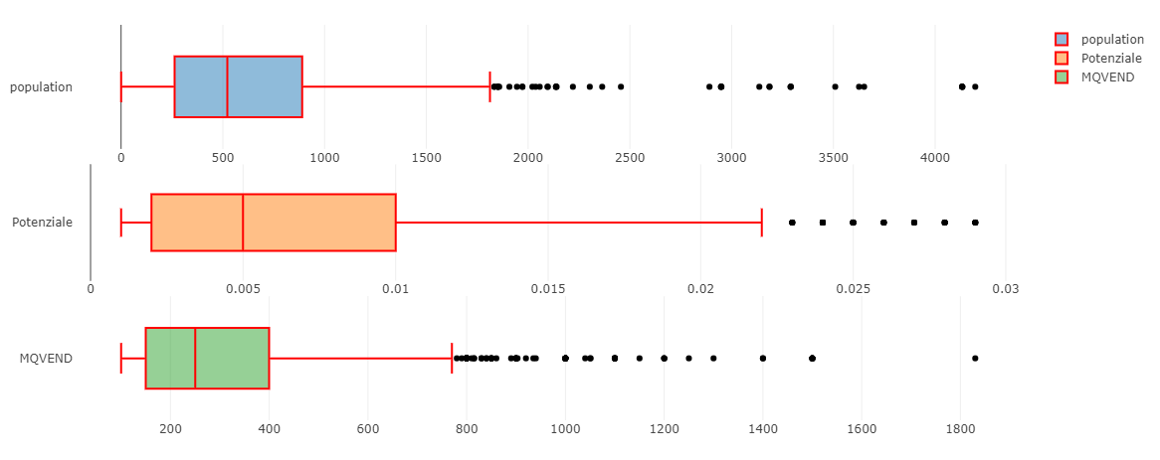
Removal of Outliers
Improves the accuracy, normalize distributions and reliability of statistical analyses.
Interquartile Range (IQR) method to identify and remove.
Outliers are identified as values that fall outside the range defined by 1.5 times the IQR.

Slide 16
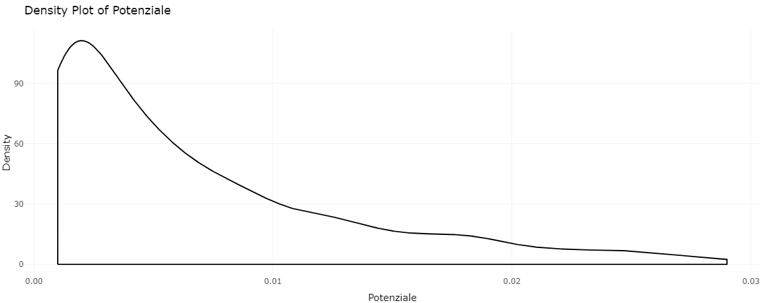
Density plot
Distribution of the data appears to be more concentrated around the central tendency.
Dataset is now less influenced by outliers for further analysis.

Slide 17
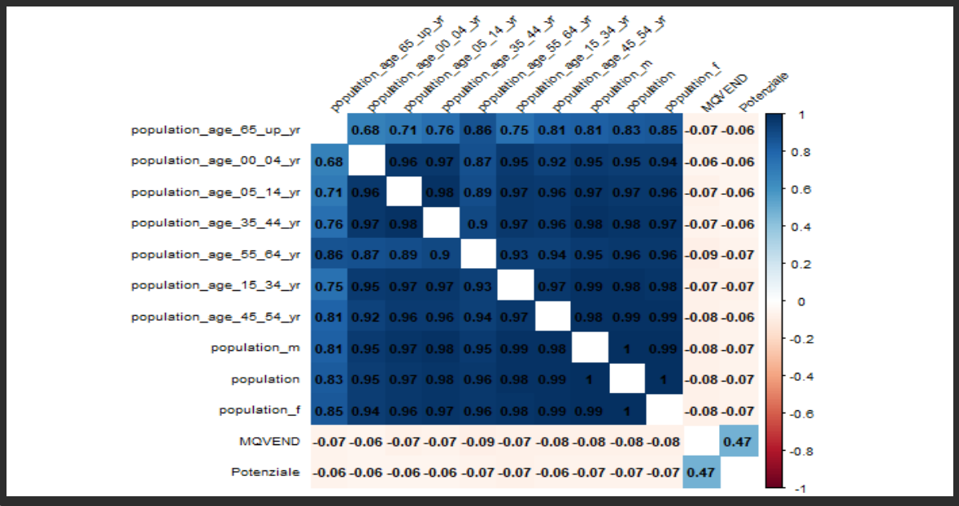
Correlation Heatmap
Visual representation of the correlation matrix, which displays the pairwise correlations between variables in a dataset.
"Potenziale" and the size of the store “MQVEND” exhibits the highest correlation.

Slide 18
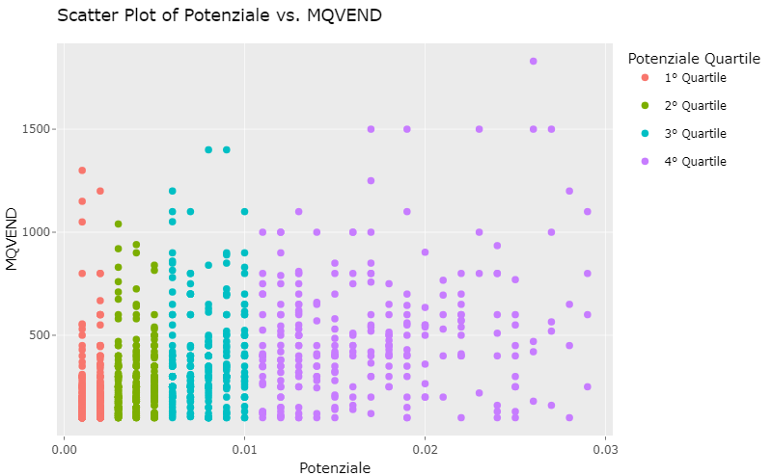
Scatter Plot
Illustrates a notable correlation between MQVEND and Potenziale variables.
Suggesting a potential relationship between store size and sales potential.

Slide 19
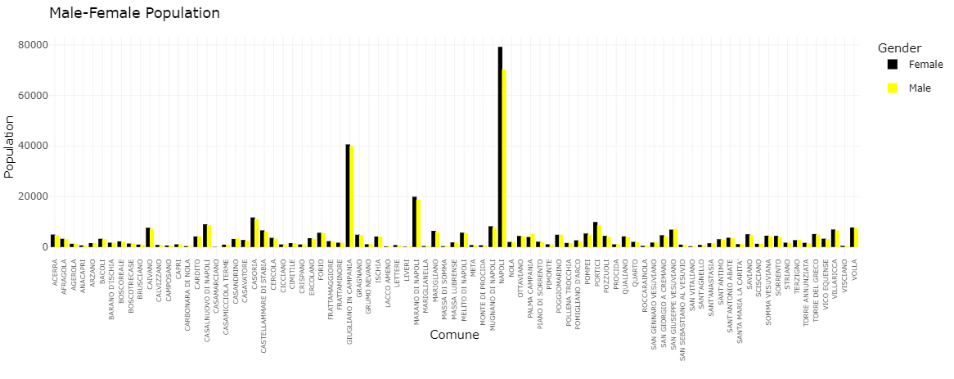
Comparison between male and female data
Aimed to identify areas where gender-based differences might impact the market.
Across most areas, the numbers of men and women are similar.

Slide 20
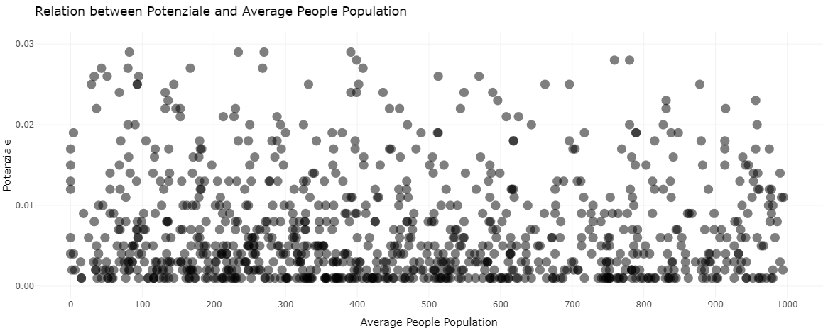
Comparison of Potential and Average People Population
Standalone population does not impact the potential of the store.

Slide 21
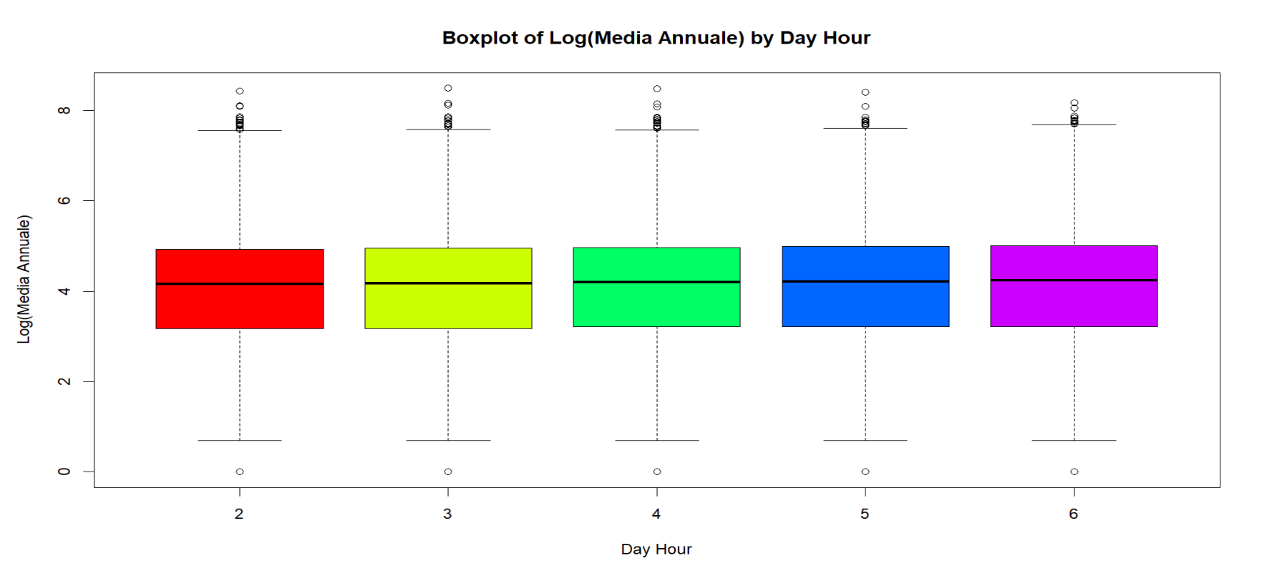
Population visiting stores everyday
Day hours:
2 – (7am – 10am)
3 – (10am – 1 pm)
4 – (1 pm – 4pm)
5 – (4pm – 7pm)
6 – (7pm -10pm)

Slide 22
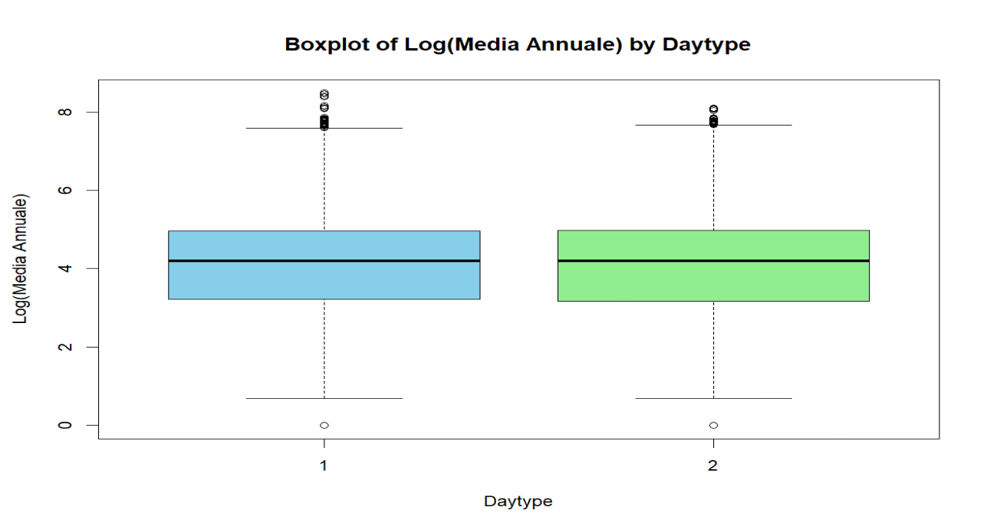
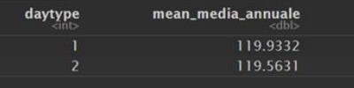
Population visiting stores on weekdays and weekends
Daytype:
1 – Saturday & Sunday (Weekends)
2- Monday – Friday (Weekdays)

Slide 23
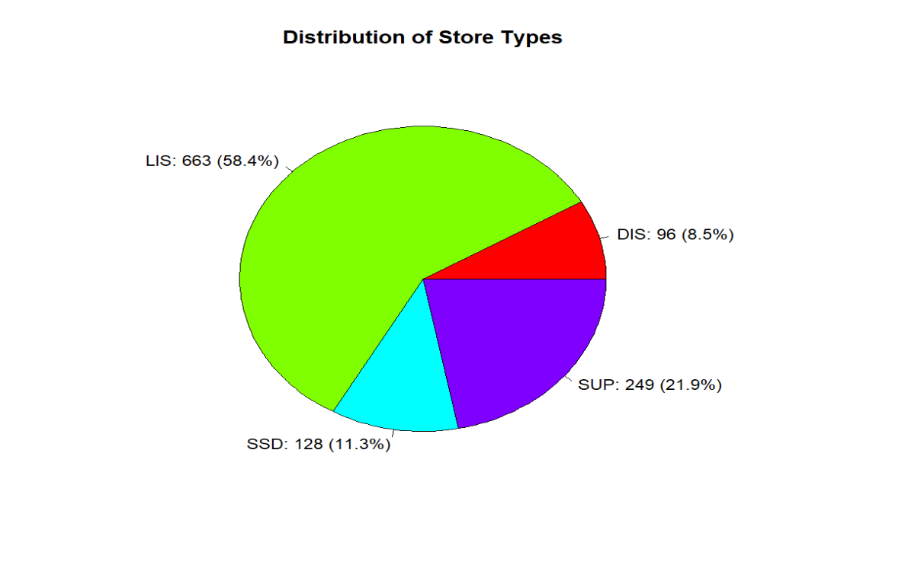
Store Distribution by Category
Libero Servizio (LIS)
Supermarket (SUP)
Drugstore (SSD)
Discount (DIS)

Slide 24
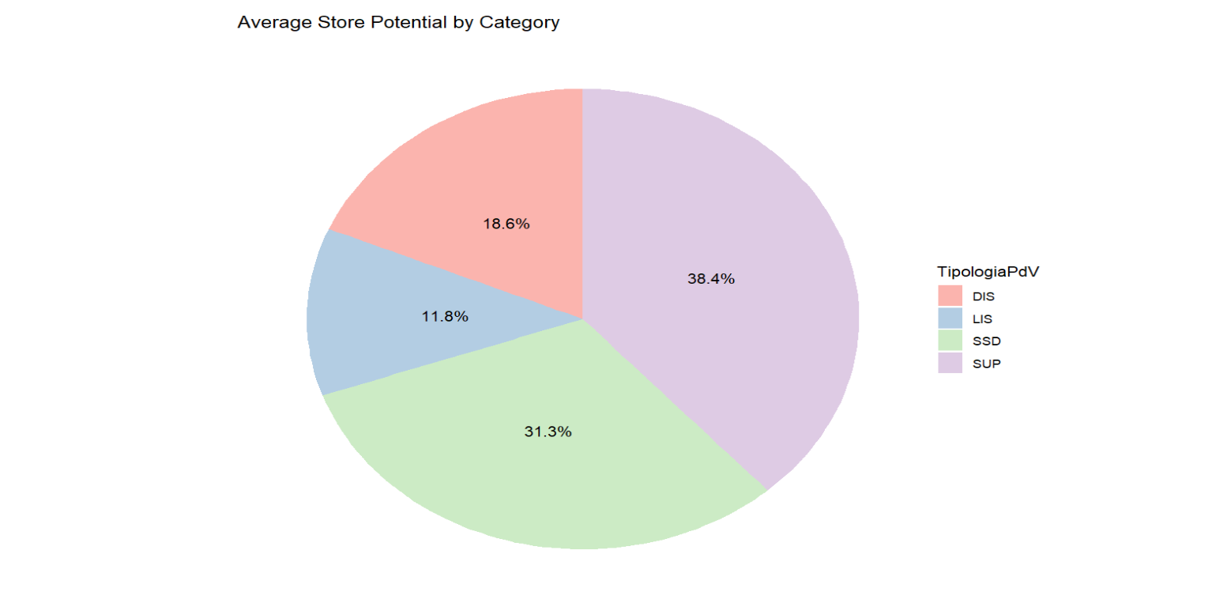
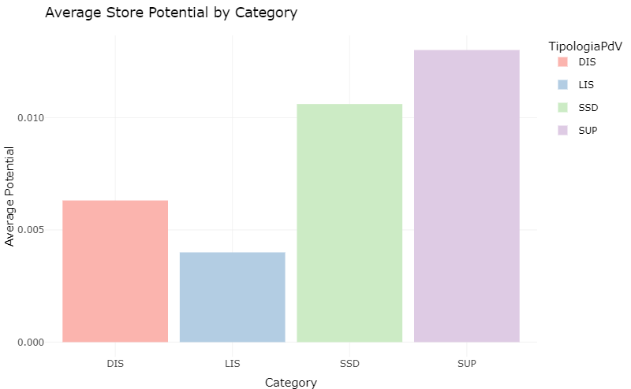
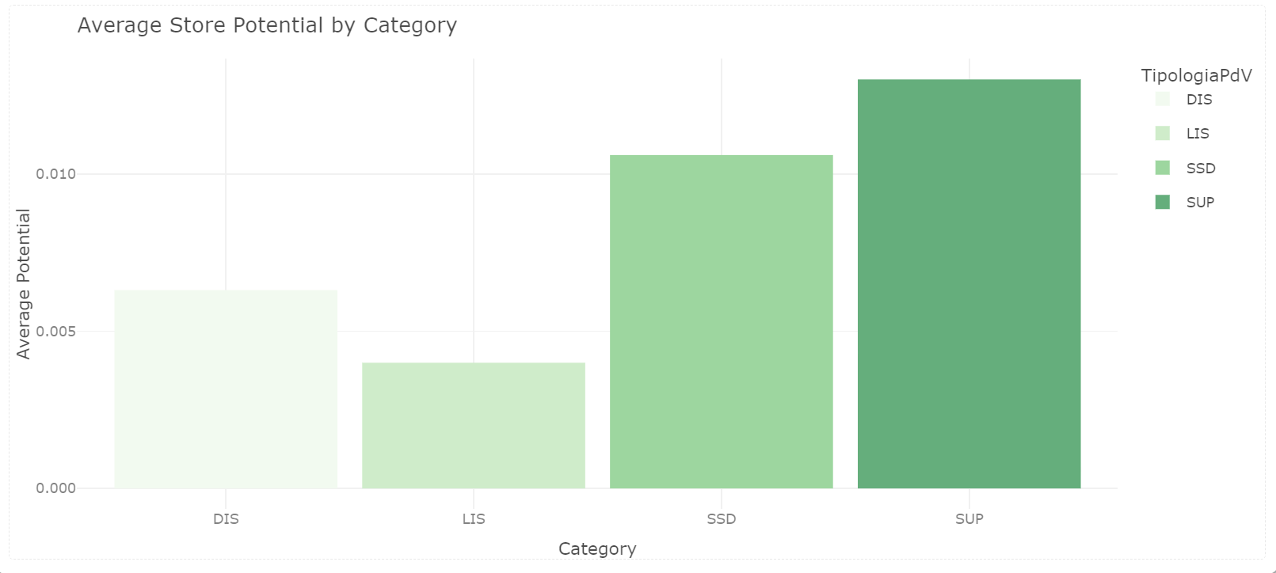
Average Store Potential

Slide 25
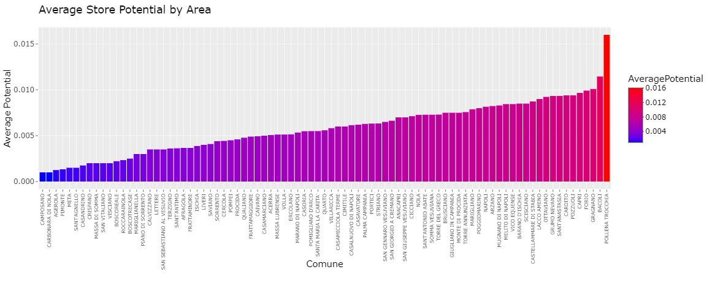
Average Store potential by Comune

Slide 26
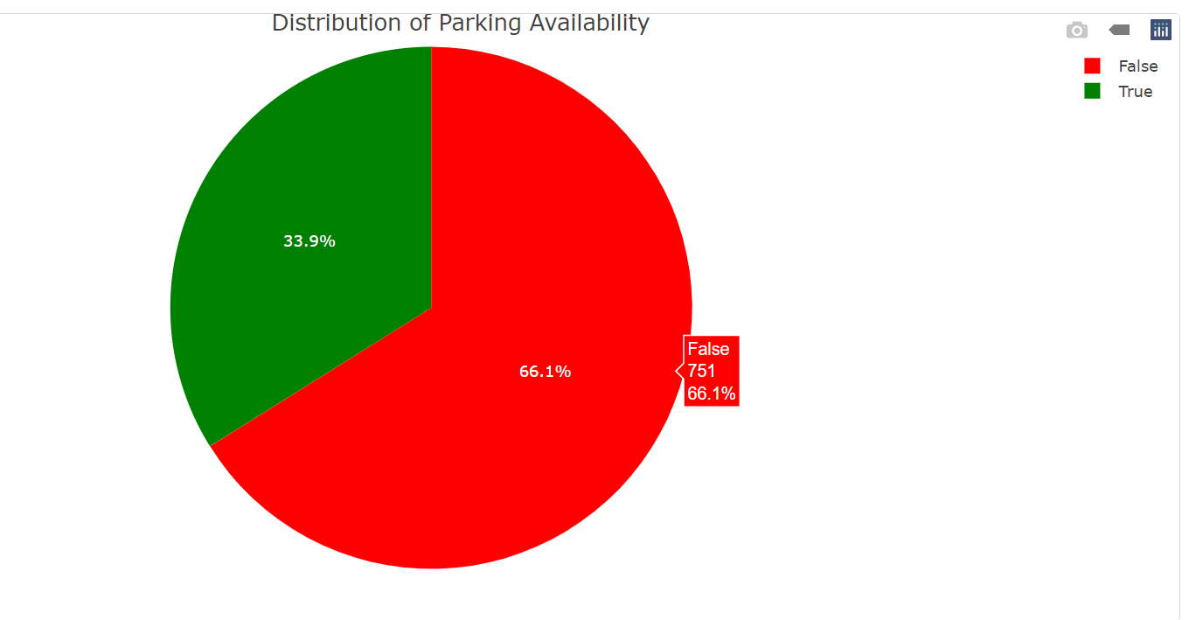
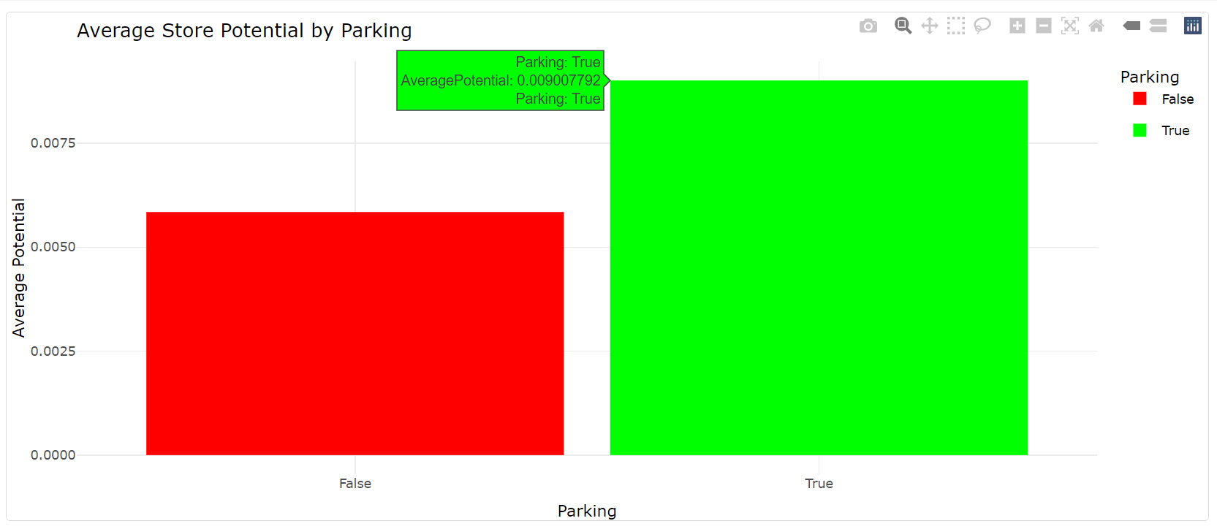
Average Parking Potential of Stores

Slide 27
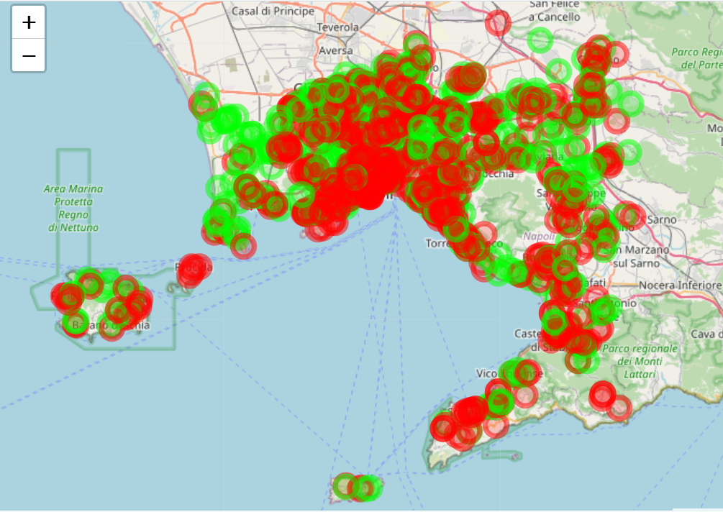
PARKING MAP
Red – No Parking
Green – Yes Parking

Slide 28
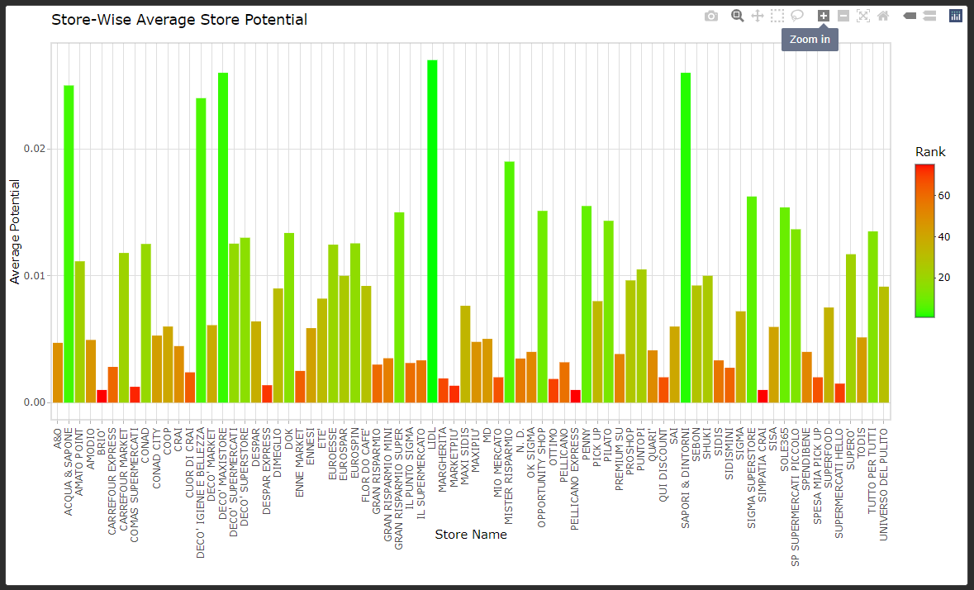
Average potential of stores brand
Top Performing Stores:
LIDL
SAPORI & DINTORNI
DECO MAXISTORE
Least Performing Stores:
SIMPATIA CRAI
PELLICANO EXPRESS
BRIO

Slide 29

Classification

Slide 30

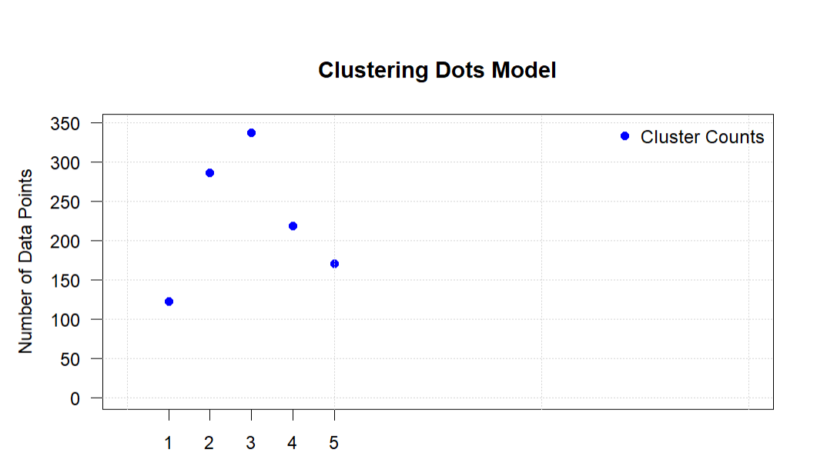
K-Means Clustering
K-means clustering is a unsupervised machine learning algorithm used for partitioning data into a predefined number of clusters.
Selecting K data points from the dataset to serve as initial cluster centers.
Each data point in the dataset is assigned to the nearest centroid based on Euclidean distance.
Cluster Dots Model shows the number of cluster counts. Total of 5 clusters are formed based on silhouette scores.
Data Points are the individual store potential.

Slide 31
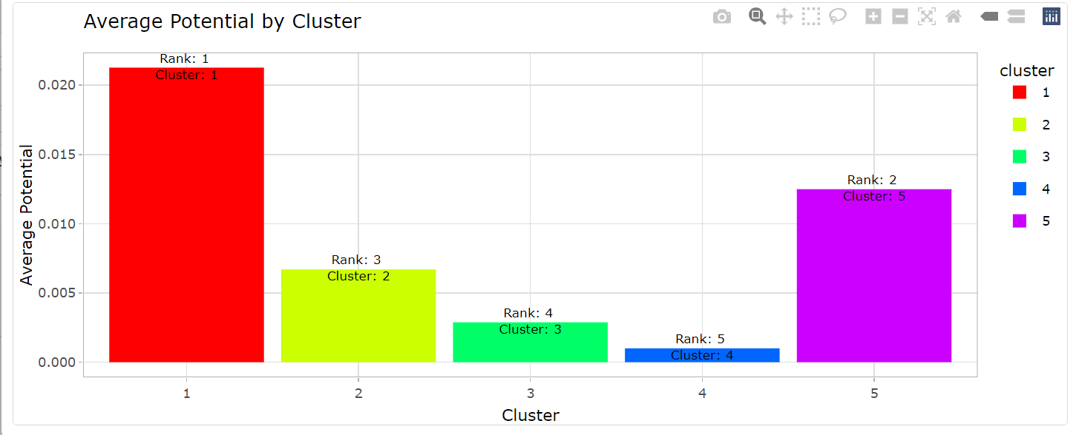
Average Potential by Cluster
The average store potential distribution across various clusters identified through K-means clustering, thereby enabling interactive exploration and analysis of potential patterns.

Slide 32
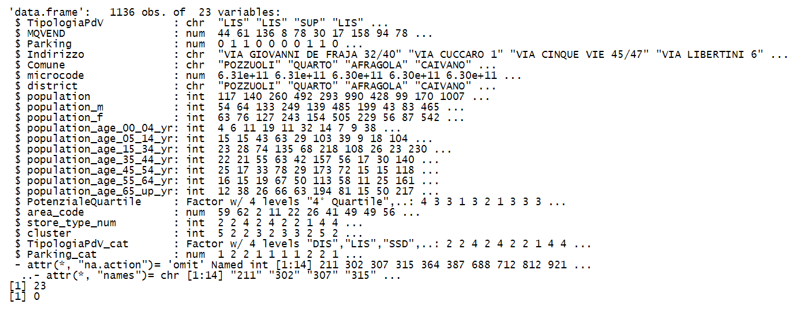
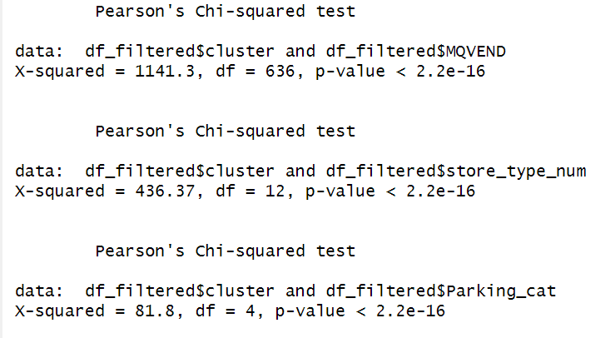
Feature Selection
Feature engineering filters variables for model building.
Prepares the data for modeling.
Builds a classification model, and examines the importance of features in predicting the target variable.
Selecting only considered features.​

Slide 33
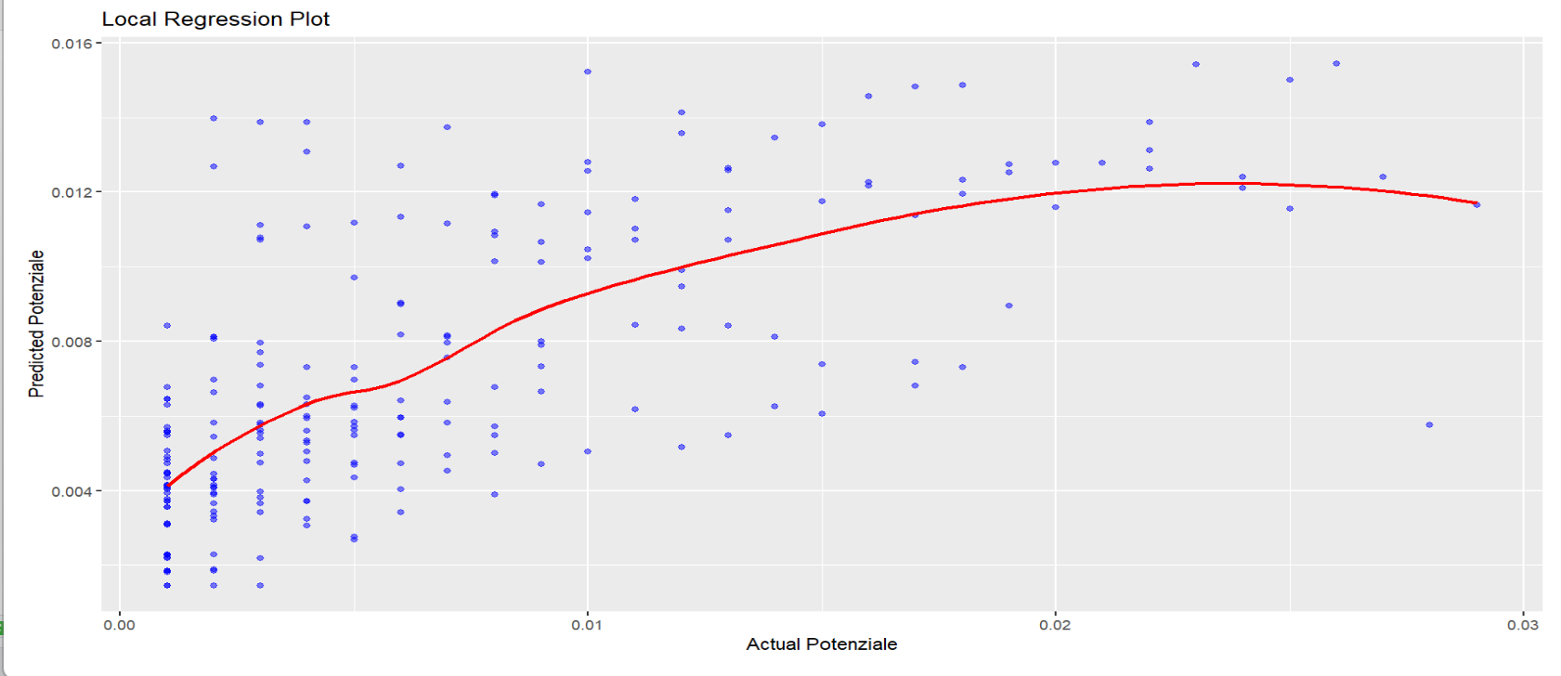
LOCAL REGRESSION
REGRESSION
PROBLEM
"R-squared: 0.4364"

Slide 34
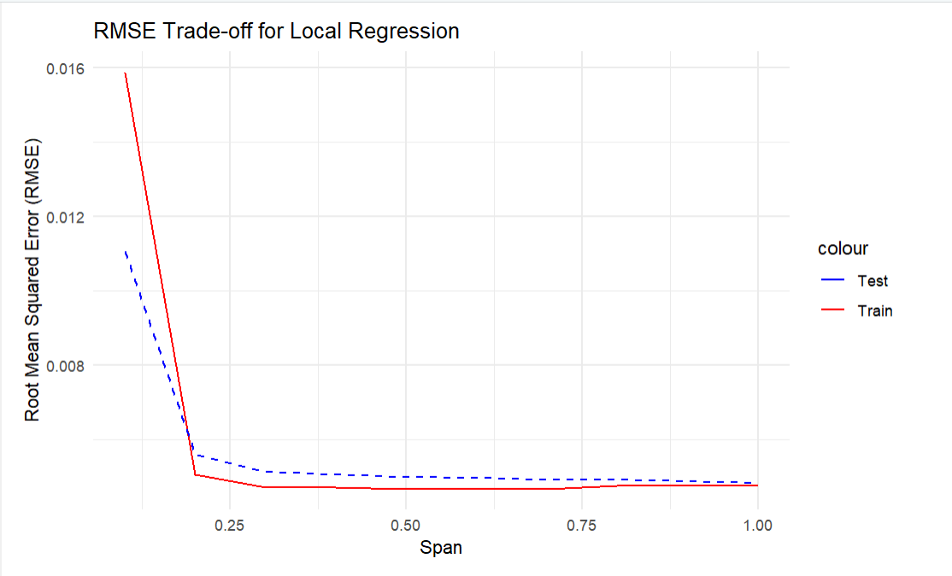
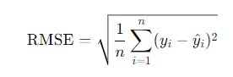
Bias-Variance Tradeoff

Slide 35
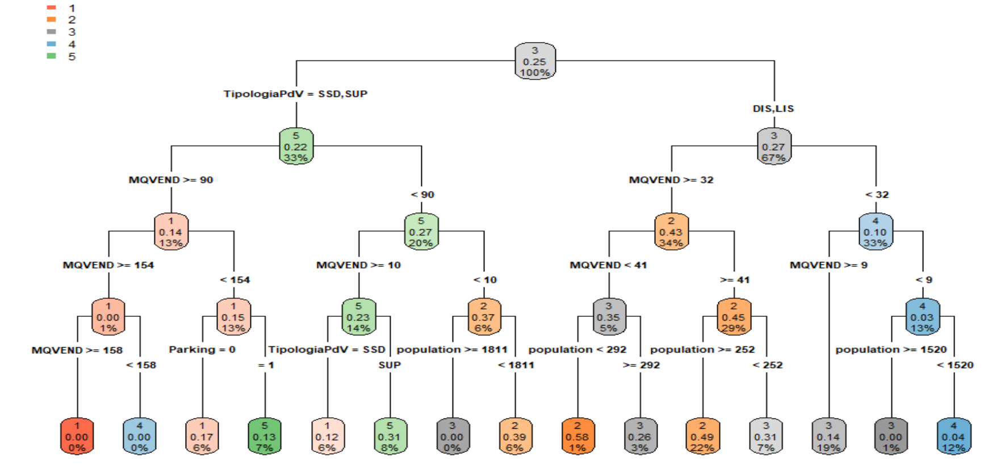
Decision Tree
"Accuracy: 47.58 %"
CLASSIFICATION
PROBLEM

Slide 36
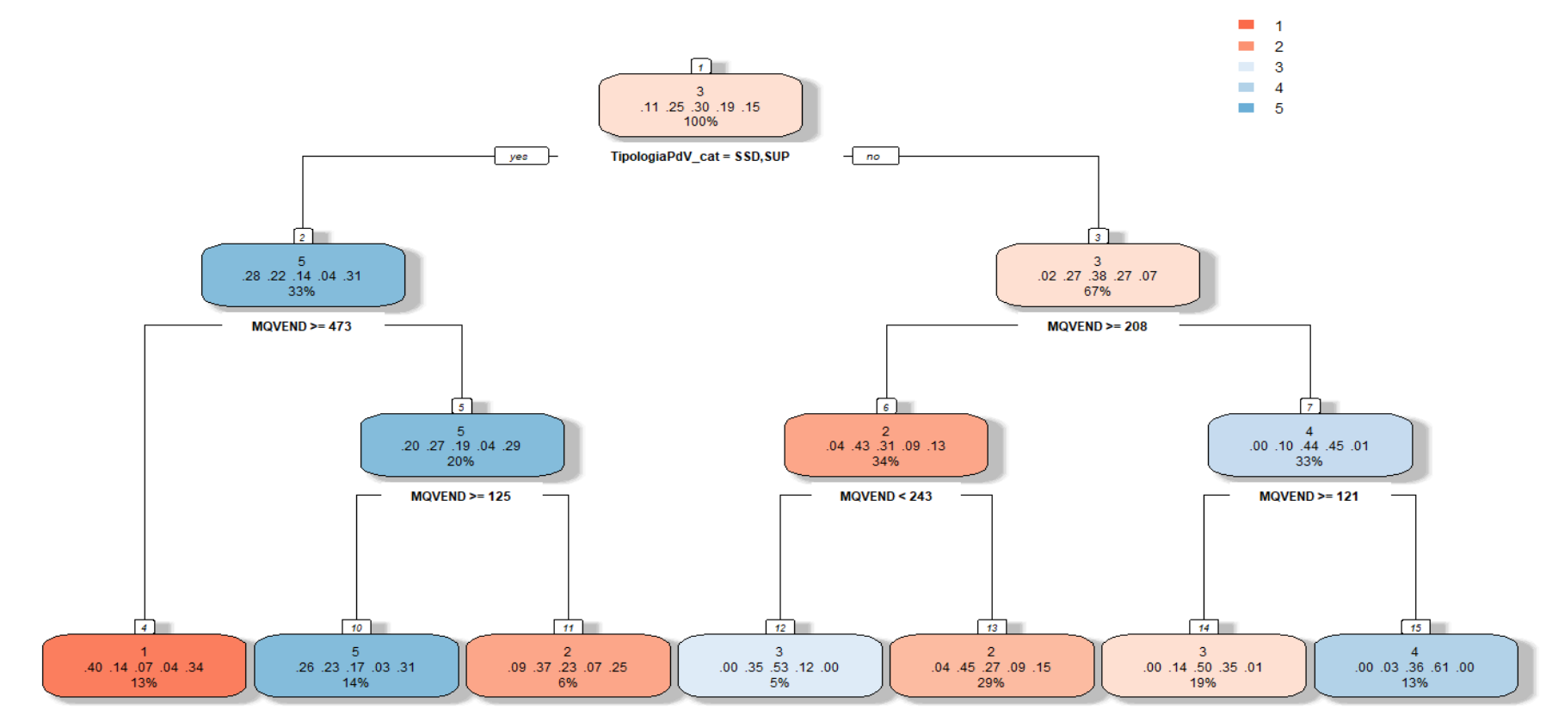
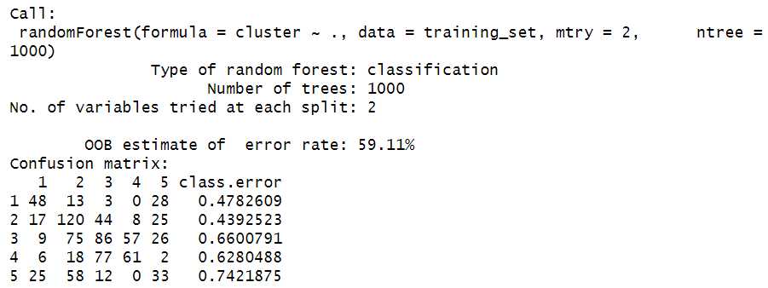
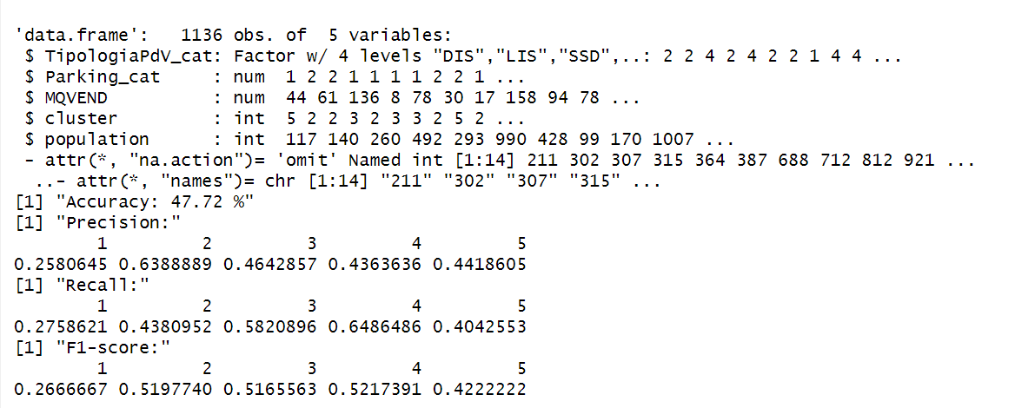
Random Forest
BAGGING:
BOOTSTRAP
AGGREGATE

Slide 37
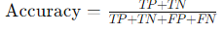
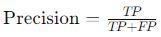
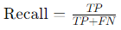
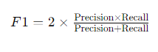
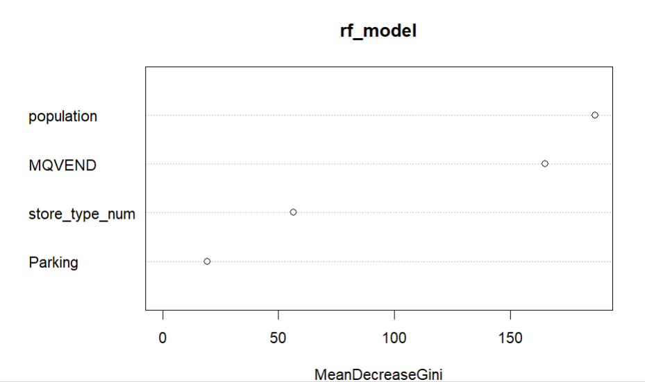
Random Forest

Slide 38



Slide 39



Conclusion
Parking Availability
Store Size
Store Type
Store Brand
Retailer can focus on marketing strategies and promotions for sale of diapers to the LIS stores to attract more potential customers. As LIS stores are high in number, an increase in sales will eventually increase the overall revenue potential. By addressing these factors strategically, retailers can optimize their store performance and store potential revenue.
This Photo by Unknown Author is licensed under CC BY-SA

Slide 40

THANK YOU FOR YOUR ATTENTION

